Slide 1


Topic Modeling on News Dataset and Fake News Detection
Team 4:
Suna Buse Agkoc, Syed Hossian, Yizhe Ling, Fengping Zhao
Notes:
Image: https://res.cloudinary.com/cognitives-s3/image/upload/c_limit,dpr_auto,f_auto,fl_lossy,q_75/v1/cog-live/n/1271/2020/Nov/05/iK4r0o89dN1SUTWmfwls.jpg

Slide 2
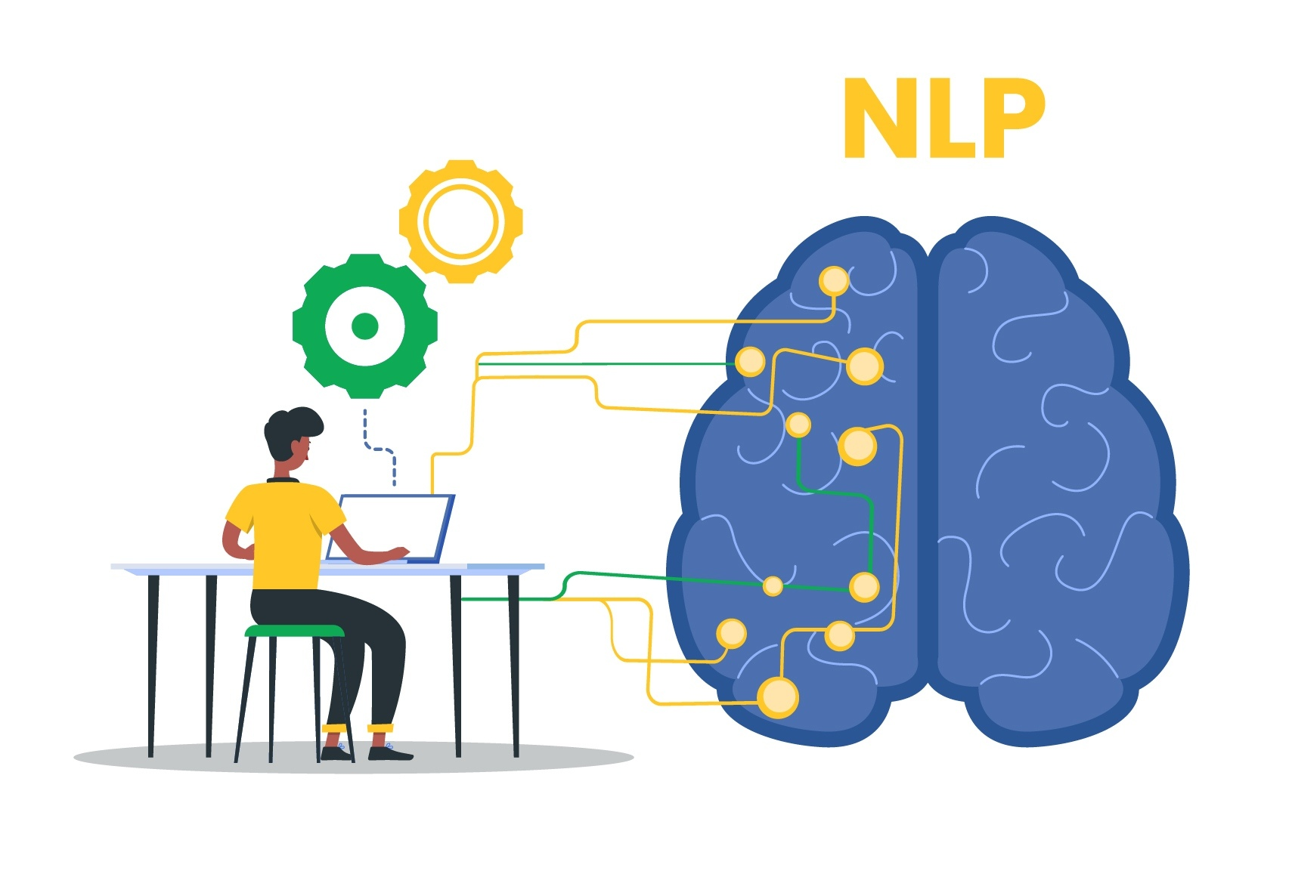
Research Questions
How can we classify fake/real news? What are the hot topics in fake/real news? Which topics have more words with negative connotations?

Slide 3

NLP Open Dataset
“Fake and real news dataset”
Clément Bisaillon
Title, Text, Subject, Date
Two CSVs: fake vs real (40k rows)
Type of Article: News, Politics, Other
Covered from 12/31/2015 - 12/31/2016
“Fake or Real News”
Number, Title, Text, Label
6,256 rows

Slide 4
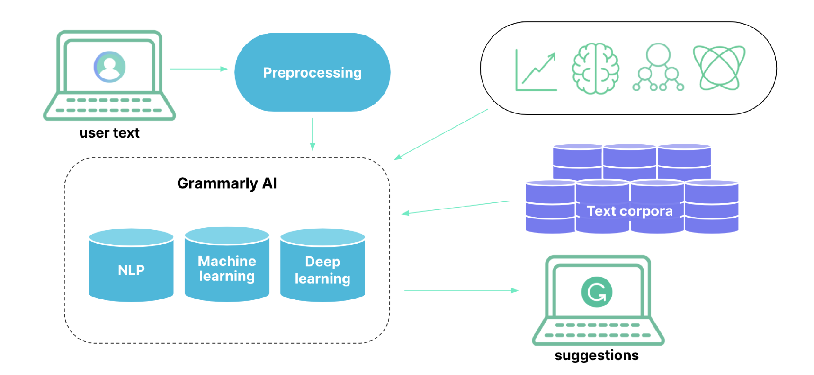
Preprocessing
Normalization
Removing stopwords, punctuation, and numbers
Lemmatization
Stemming

Slide 5
Analysis
To answer our first RQ, we’re going to use some ML algorithms (i.e., Logistic Regression) to classify fake/real news.
N-gram analysis
Tf-Idf
Topic Modeling
Sentiment Analysis

Slide 6

Practical implications
26% of Americans feel confident in their ability to identify fake news, 67% of Americans believe that fake news causes great confusion. (from Statista’s database)
Improve people’s ability to identify fake news and their perception of real news
The news media can help society reduce social conflict by filtering news that contains more negative connotations
Reduce socially harmful controversies/polarization
Ensure to have more healthy society

Slide 7

Thank you!
Notes:
image:https://st.depositphotos.com/2291517/4015/i/600/depositphotos_40155451-stock-photo-any-questions-concept.jpg

